Slide 1
Registration
© 2018 AMER

Slide 2
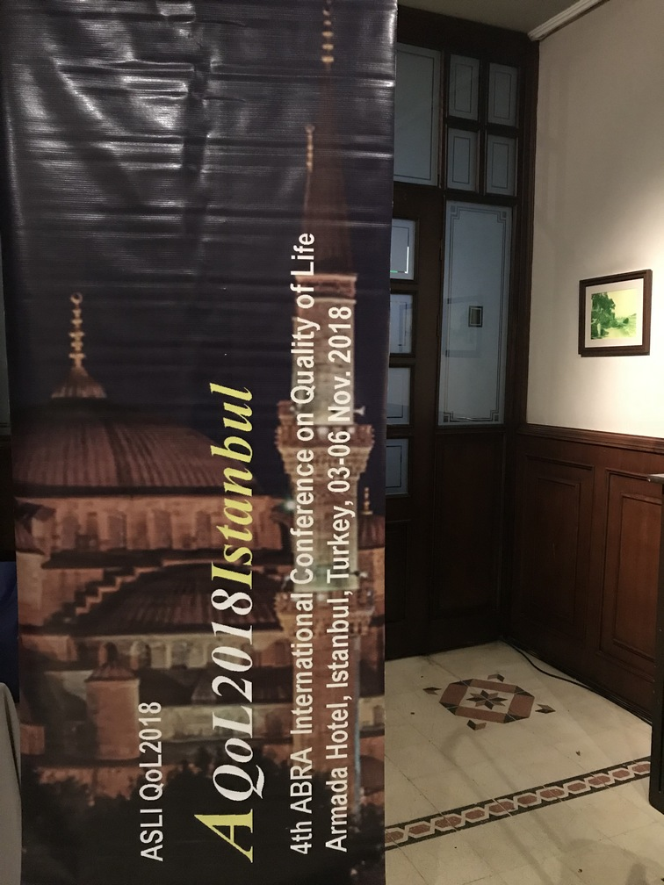
© 2018 AMER

Slide 3
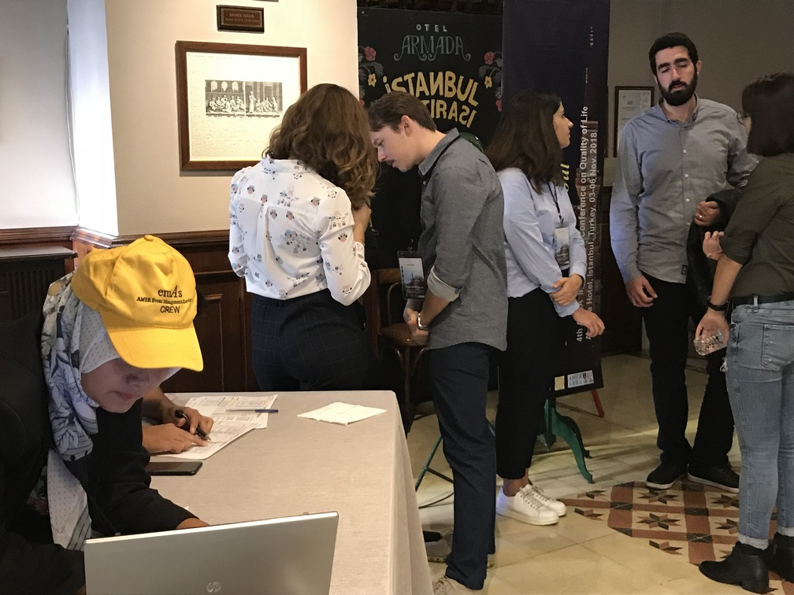
© 2018 AMER

Slide 4
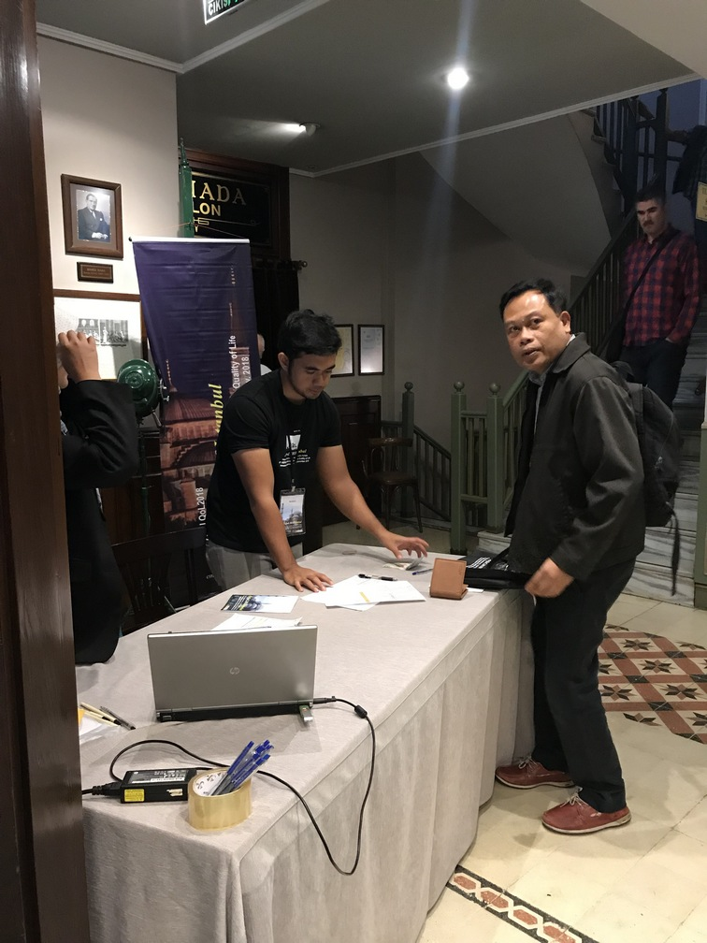

Slide 5
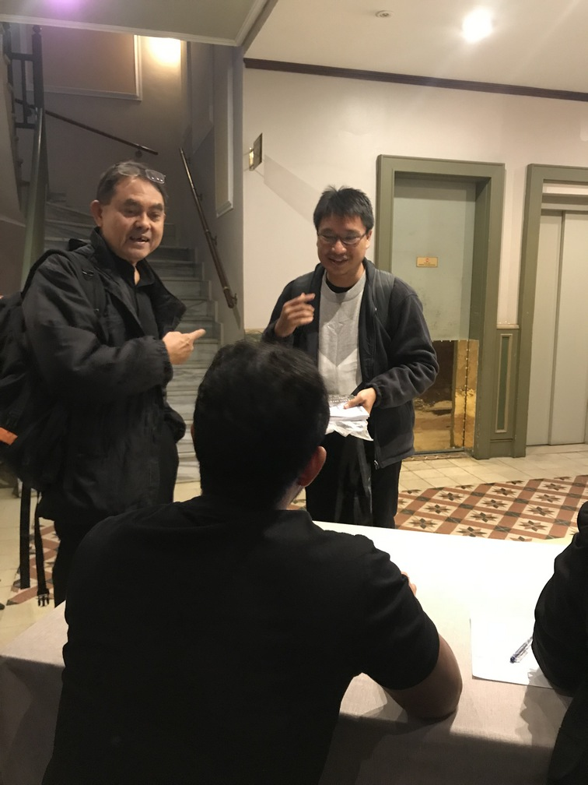
© 2018 AMER

Slide 6
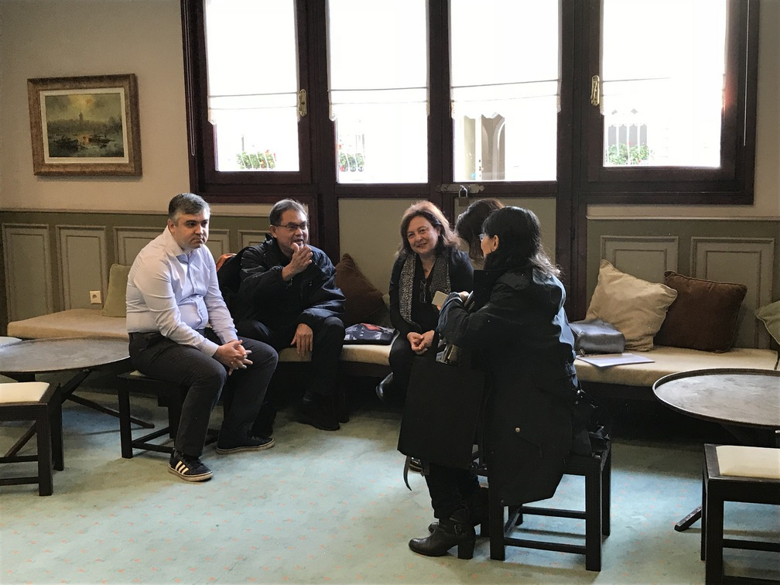
© 2018 AMER

