Slide 1
ISC Networking & ABRAturkey Formative
© 2018 AMER

Slide 2
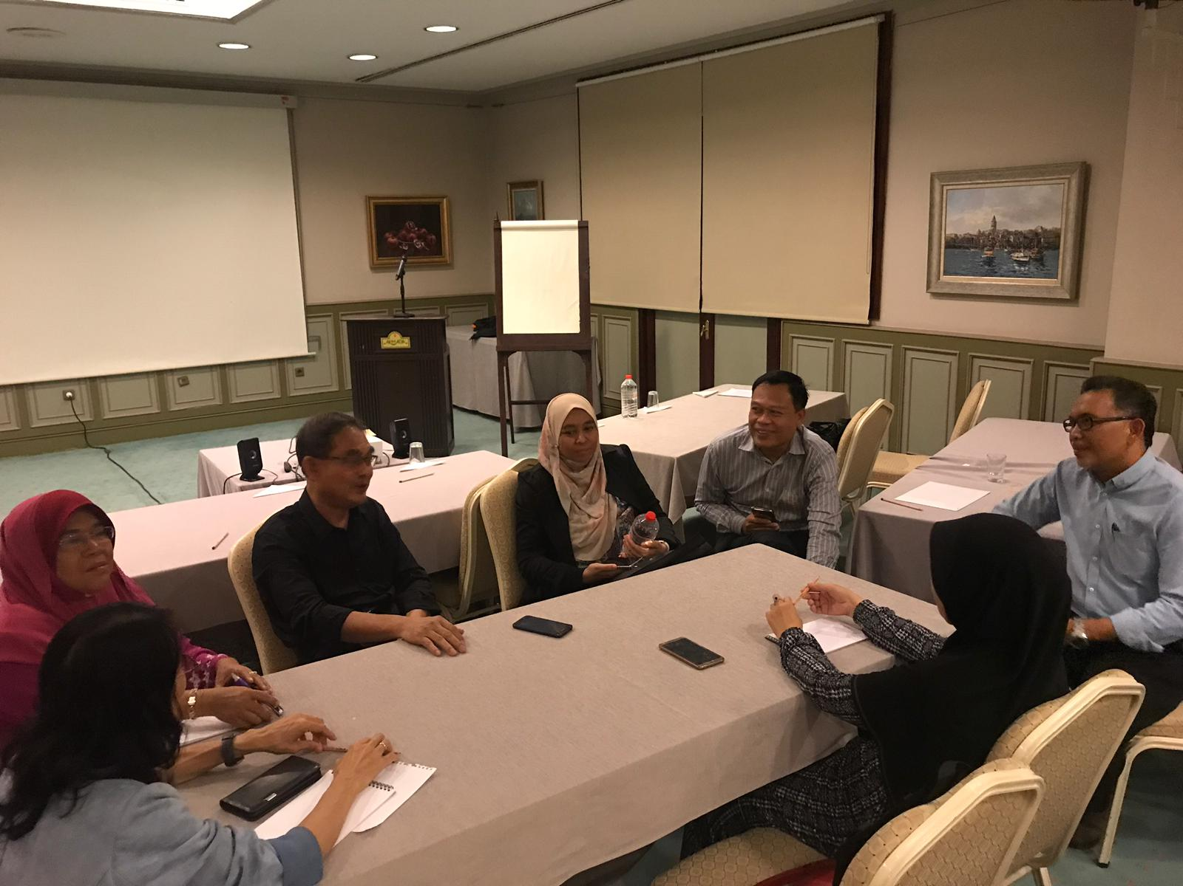
© 2018 AMER

Slide 3
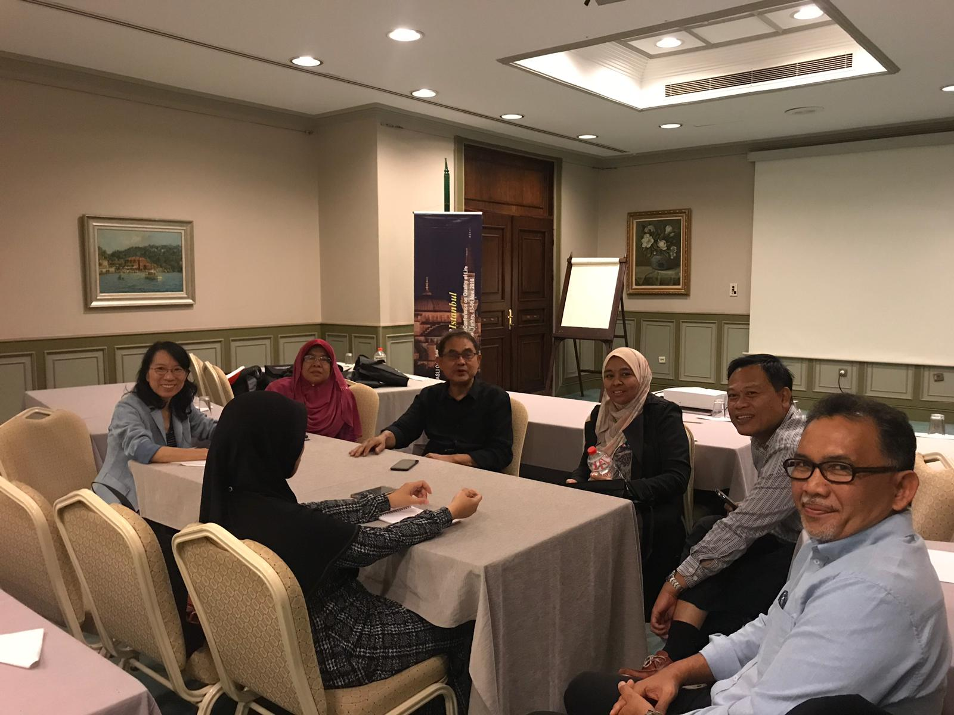
© 2018 AMER

Slide 4
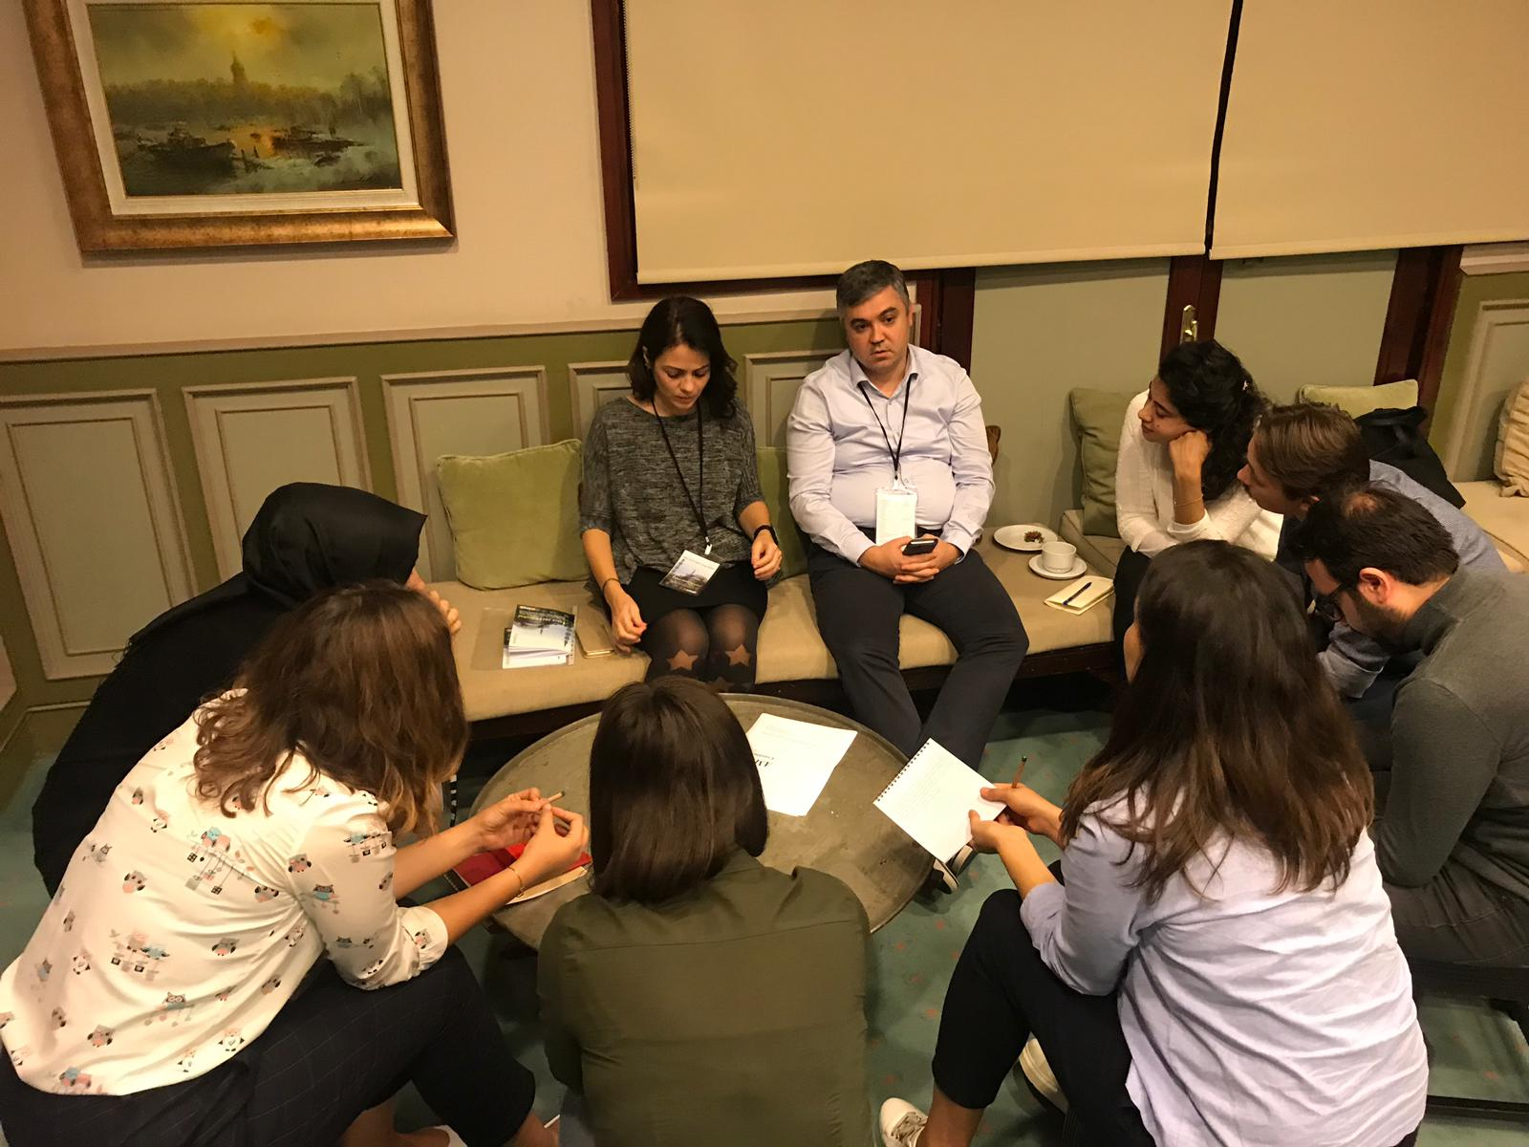
© 2018 AMER

